Slide 1
Coding Challenge
Team 12- Bonds App
Alexandru Raducanu, Virginia Chirca, Teodora Dumitrescu, Xizhen Huang, Neeharika Mittra

Slide 2
Challenges & Objectives
Objectives
Making an application that has a user-friendly interface
Helping users to be up to date on the transactions occurring with their bonds
Securing the application correctly as it contained sensitive information of registered users
Challenges
Many of us were new to react, which made it challenging for us to work on certain components and understanding react principles
Merging Conflicts and using github versioning for code
Understanding the data and the concepts that contained banking terminology
Notes:
- Eg data only flows from parent to child (unidirectional)

Slide 3
Architecture of the application
H2 Relational Database (Backend)
Normalization of data tables
Creating and populating the data tables
Ensuring Data integrity with the help of foreign keys
Java Application (Mid Tier)
Creating models for each data table
Using controllers to fetch data
Creating tests to ensure our methods work as intended
React JS (Frontend)
Use of google firebase to create the login functionality
Creating components and choosing a tree structure for our app
Managing the data flow between components

Slide 4
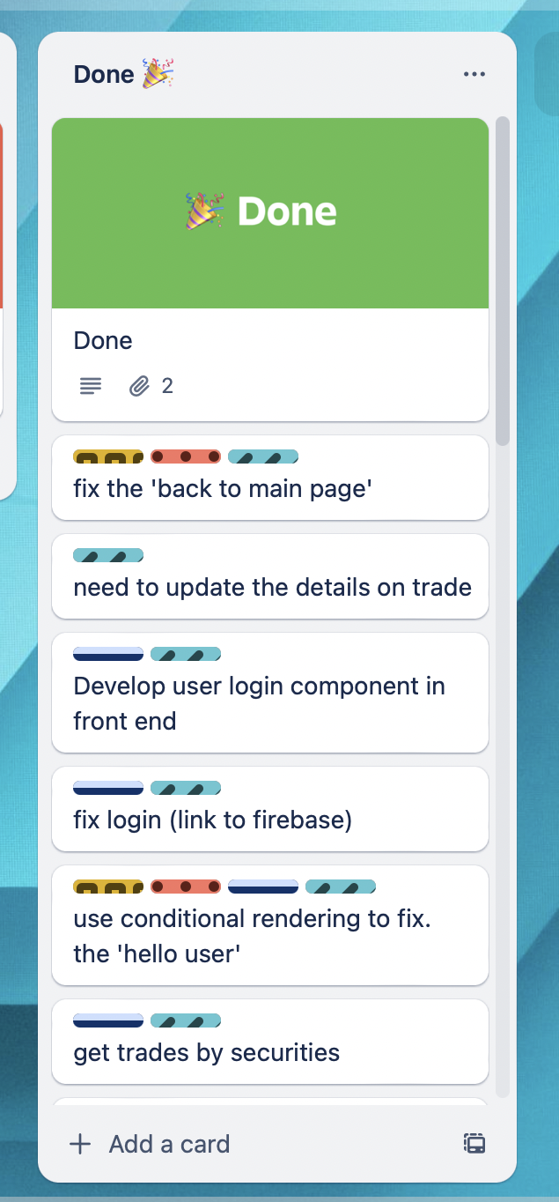
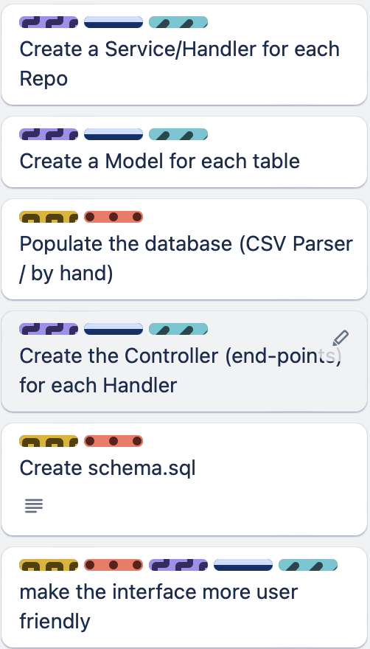
Team Work & Collaboration
An Agile team
Through the use of Trello boards, we were able to assign tasks to different group members to ensure that we are meeting deadlines.
Pair Programming
To ensure efficiency, we chose to use the pair programming technique, which allowed us to split into sub groups and help each other complete the tasks.
GitHub
We used different branches on our GitHub repository to take everyone’s ideas into consideration and work parallelly on various tasks

Slide 5
Conclusion & Improvements
Conclusion
Through the process, we were able to develop our technical capabilities
We learnt about how to work together in an agile team
Accepting different ideas with the implementation of the best ones
By deciding on which milestones to be achieved on each day, we were able to manage our time effectively.
Improvements
Adding functionalities described in MVP 2.0
Bettering the user experience by using different languages
Refine functionalities based on feedback from users
Notes:
- Eg data only flows from parent to child (unidirectional)

